Slide 1
Vulcan Defect Status
May. 30, 2016
Tao Wu, Wen Yi Gao

Slide 2
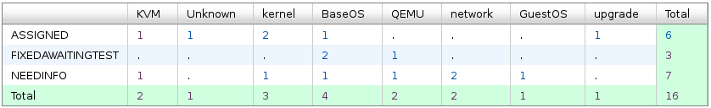
Vulcan - Open Defects
16 open defects excluding 5 HVM bugs.
2 new defects were opened in the last two weeks. We solved 6 defects in the past two weeks.
Defect statistics:

Slide 3
Vulcan – High Priority Defects
No | ID | Pri | Sev | Comp | Summary | Status | Comment
1 | 136145 | P1 | High | upgrade | kvmibm-upgrade-system -y upgrading Kronos FP1 to Vulcan RC2, hangs running: lvm lvs --noheadings -o vg_name /dev/mapper/s93kvh--fp--zkvmvg-root | ASSIGNED | - Cloned to MCP for further investigation.
2 | 140835 | P2 | High | Unknown | User process fault: interruption code 0x40011 in multipathd while booting Vulcan FP2 | ASSIGNED | - Under investigation.
3 | 135658 | P2 | High | network | Getting Tainted Kernel messages against openvswitch - specific to ovs-gre guests | NEEDINFO | - May be documented. - Waiting for the bug owner's feedback.

Slide 4
Vulcan – All Defects
445 defects excluding 117 HVM defects opened in the Vulcan Bugzilla until now.

